Slide 1
The Modern Educational Course on Agile Software Development
Kirill Kornyakov, Evgeny Sorokin
Computational Mathematics and Cybernetics department,
N.I. Lobachevsky State University,
Nizhny Novgorod, Russia

Slide 2
Agenda
Information about the project
Motivation
Key course ideas
Course outline
Labs
Project status
Future work

Slide 3
The Project
The team
Evgeny Sorokin (UNN, Intel software engineer)
Anton Bevzuk (Intel senior software engineer)
Kirill Kornyakov (UNN, Itseez software engineer)
Our colleagues from UNN, Intel, Itseez
Project start: early 2009
Approbations:
Master Course on CMC department (Fall 2009)
Annual Summer and Winter Schools

Slide 4
Adoption Rate of Agile Techniques

Slide 5
How Have Agile Approaches Affected the Quality of Systems Deployed?

Slide 6
Motivation: Why Agile?
Agile is a set of iterative and incremental development methodologies with emphasis on building releasable software in short time periods.
Agile methodologies are a trend nowadays. They are proven to be very effective for specific class of software projects. It is very likely that young software engineer will participate in an agile software project.
Regardless of this, every developer need to now basic agile development principles and practices, which help to create high-quality, maintainable and flexible software systems.

Slide 7
Motivation: Why Agile Course?
There is no complete course, covering agile methodologies.
We can see numerous materials about Agile:
Pioneering books about Agile Development and their followings.
Commercial training courses by consulting companies.
Extensive research on applicability of agile practices in various environments.
There is still a lack of Agile Development courses with strong practical orientation.

Slide 8
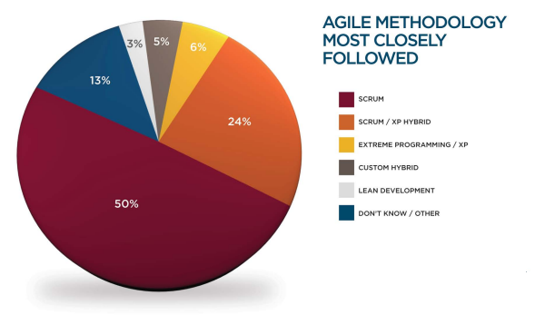

Key Course Ideas

Slide 9
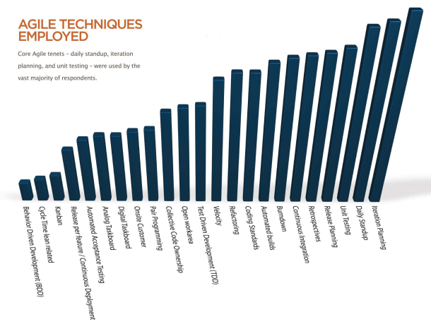
Key Course Ideas

Slide 10
Key Course Ideas
Theoretical part (how to organize work)
To give an overview of the full spectrum of agile methodologies.
To show widely accepted practices and to show corrections made by time.
To use real life experience.
Practical part (how to write agile code)
To discuss key concepts (practices, principles and patterns).
To introduce development tools.

Slide 11
Course Outline
Agile Development
Scrum
eXtreme Programming
Architectural styles
Domain-Driven Design
SOLID OOD principles (SPR, OCP, LSP, ISP, DIP)
Test-Driven Development (+lab)
Model-View-Presenter pattern (+lab)

Slide 12
Labs
The goal of TDD lab is to practice refactoring to patterns, to let students see the value of TDD and to educate dependency management. Tools play important role here.
MVP lab is aimed for practical usage of this GUI level pattern. Students learn one of the most useful patterns and understand how the OO and patterns help to create flexible systems.

Slide 13
Project Status
Initial version of the course have been created and approbated.
Nizhny Novgorod State University facilities are used as a basis for initial course approbations. The course has been conducted as the Master's course on Computational Mathematics and Cybernetics department of State University of Nizhny Novgorod.
The course have been tested at Winter and Summer Schools (annual sessions) at ITLab.

Slide 14
Future Work
We are working on handbook for the course. It will be released this autumn.
We plan to enlarge significantly the practical part of the course. Database-related topics and some other useful patterns will be added. Student are supposed to use team collaboration tool (GoogleCode, Redmine, GitHub).
Course materials will be available online for free.

Slide 15
Questions?
kirill.kornyakov@gmail.com
Thank you!

